Slide 1
UML (Unified Modeling Language)

Slide 2
Use Cases
What is a Use Case
  A formal way of representing how a business system interacts with its environment
  Illustrates the activities that are performed by the users of the system
  A scenario-based technique in the UML
  A sequence of actions a system performs that yields a valuable result for a particular actor.

Slide 3
Use Cases
A use case is a summary of scenarios for a single task or goal.
An actor is who or what initiates the events involved in the task of the use case. Actors are simply roles that people or objects play.
So as we read our scenario, what or who is the actor????

Slide 4
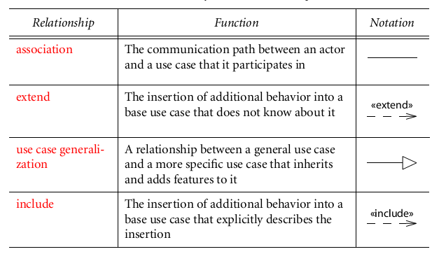
A use case can participate in several relationships, in addition to association with actors

Slide 5
Types of Use-case
1.Including Use Cases:
Although each use case instance is independent, but a use case can simply incorporate the behavior of other use cases as fragments of its own behavior. This is called an include relationship.
In general it is assumed that any included use case will be called every time the basic path is run.
An example of this is to have the execution of the use case <Card Identification> to be run as part of a use case <Withdraw>.

Slide 6
2. Extending Use Cases
A use case can also be defined as an incremental extension to a base use case. This is called an extend relationship.
One use case may be used to extend the behavior of another.
There may be several extensions of the same base use case that may all be applied together.
This is typically used in exceptional circumstances.

Slide 7
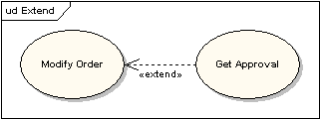
2. Extending Use Cases
For example, if before modifying a particular type of customer order, a user must get approval from some higher authority, then the <Get Approval> use case may optionally extend the regular <Modify Order> use case.

Slide 8
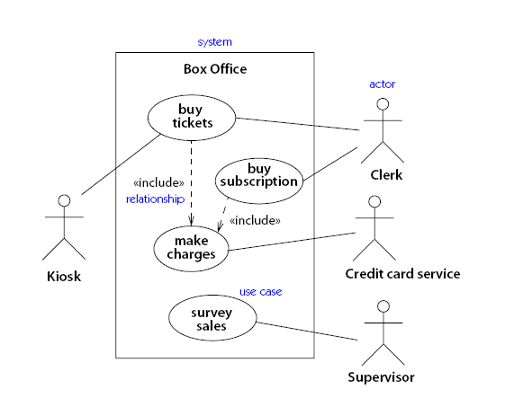
Example:

Slide 9
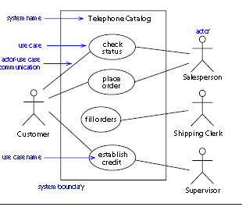

Slide 10
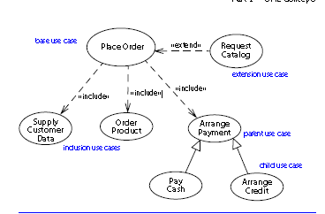

Slide 11
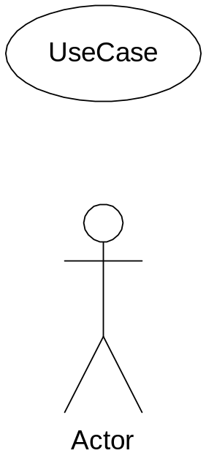
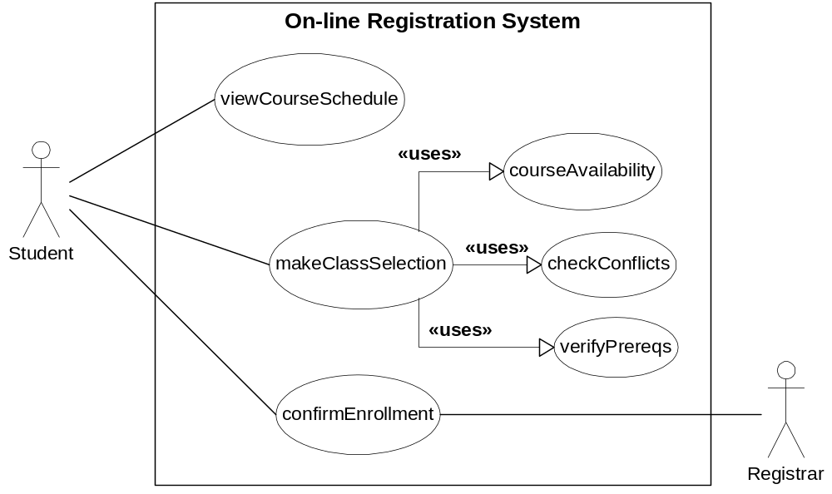
Use Case Diagram Example

Slide 12
Use Case Diagram Practice
We will build use case diagram for a Altered State University (ASU) Registration System.
Look and identify potential actors and use case tasks.
Nouns and verbs may be helpful.
Notes:
Video Rental System
Actors
Customer
Video distributer
Use cases
Enroll as member
Check out video
Return video
Order new video

Slide 13
Example #2
Altered State University (ASU) Registration System
1. Professors indicate which courses they will teach on -line.
2. A course catalog can be printed
3. Allow students to select on- line four courses for upcoming semester.
4. No course may have more than 10 students or less than 3 students.
5. When the registration is completed, the system sends information to the billing system.
6. Professors can obtain course rosters on - line.
7. Students can add or drop classes on - line.

Slide 14
